Slide 1





AWD - CodeSync
PROJECT
DAYCARE
CENTER
Team: Danna Andrade, Danny Ayuquina, Xavier Altamirano

Slide 2


AWD - CodeSync
ABOUT NICE KIDS
Nice Kids is an inclusive daycare center with 4 levels of education that seek to develop the comprehensive growth of its children, covering cognitive, physical, social and emotional areas.
These 4 levels are:
Nursery I y II
Initial education I y II

Slide 3

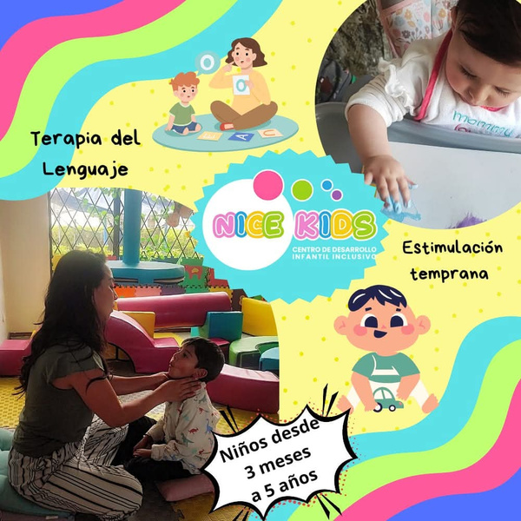
AWD - CodeSync
ABOUT NICE KIDS
Also, they offer guided homework, psychopedagogical evaluations, and speech therapy.
Their activities include music, interactive games, language stimulation, and neuropsychological rehabilitation.

Slide 4


AWD - CodeSync
ABOUT NICE KIDS
In general, the vision of the nursery focuses on providing quality education and care to all children in its care, adapting to each situation with the goal of providing the best service to its clients.

Slide 5



AWD - CodeSync
PROBLEM
The problem at Little Kids daycare is that many daily operations are managed manually, leading to inconsistent attendance tracking, poor communication with parents and difficulty organizing weekly activities. This lack of coordination causes errors, confusion, and limited control over essential operations such as student data management, activity scheduling, and attendance reporting.

Slide 6

AWD - CodeSync
OVERVIEW
In early childhood education, organization and communication are key to effective care and learning. The proposed system will act as an integrated platform to simplify daily administrative tasks and promote active participation among teachers, parents, and director
Integrated system for managing daycare administrative and educational activities.
Enables digital attendance recording with time tracking.
Automatically reports late arrivals to parents.
Weekly activity planner visible to parents, but specially for teachers as a guide.
Directors can manage staff, payments, and monitor activities.
Parents can view attendance, activities, and teacher comments.
Promotes communication, transparency, and organizational efficiency.

Slide 7
AWD - CodeSync
BACKGROUND
Manual data entry methods cause inefficiency, errors, and data loss. In contrast automated system improves accuracy, storage, and communication, futhermore role-based access ensures data security and accountability:
Director: Manages payments, staff, and communication.
Teacher: Handles attendance, activities, and progress reports.
Parent: Views attendance, activities, and child observations.
So in this way the focus shifts from administrative tasks to educational quality.

Slide 8
AWD - CodeSync
DAYCARE CENTER SYSTEM
Existing systems handle administration but lack child-focused features.
Manual systems are low-cost but prone to errors and delays.
Proposed system integrates both usability and automation:
Registration of students, teachers, and parents.
Attendance tracking with automatic time logging.
Late arrival alerts and video updates for parents.
Payment management, report generation, and internal communication.
Goes beyond standard CRUD by adding intelligent monitoring and reporting tools.
Benefits: better communication, fewer errors, faster decisions, and transparency.

Slide 9

AWD - CodeSync
CREATE
ACTIONS
Register new students, teachers, and user accounts.
READ
View student records, attendance reports, and activities.
UPDATE
Modify activity schedules, student details, and reports.
DELETE (LOGICAL)
Perform logical deletion of inactive users or students (not physical removal).

Slide 10
AWD - CodeSync
Automatic attendance tracking with the exact time the child arrives and leaves.
Automatic detection of late arrivals and alerts sent to parents.
Automatic generation of daily attendance reports.
Weekly or monthly attendance summary available to the principal.
Interactive activity calendar editable by teachers (Monday through Friday).
Daily record of observations of each child's performance and behavior.
Automatic generation of personalized reports on student progress.
ACTIONS

Slide 11
AWD - CodeSync
Internal messaging system between principal, teachers, and representatives.
Notification center for alerts, new messages, or payment reminders.
Role-based access control, ensuring different permissions for each type of user.
Audit log (logbook) that stores the actions performed by users.
Export reports to PDF, Excel, or print formats.
Advanced search and filtering to locate students, dates, or activities.
Monitor staff performance based on attendance and tasks completed.
Automatic logout due to inactivity for added security.
ACTIONS

Slide 12
THANK
YOU!

